Slide 1
FlyFast Airlines : Customer Analysis
IST707, Spring 2020
Aditya Tornekar
Paridhi Rajyaguru
Rishabh Upadhye

Slide 2
Data Overview
We studied the survey of thousands of airline customers, with special focus on FlyFast Airways Inc.
FlyFast airways had responses from 1147 customers, across several attributes -
Flying related variables: airline status, class, flight time, distance, delays etc.
Customer specific variables: age, gender, price sensitivity, purpose of travel and so on
The customers were asked to score on a scale of 1-10, their “Likelihood to Recommend” the airline.

Slide 3
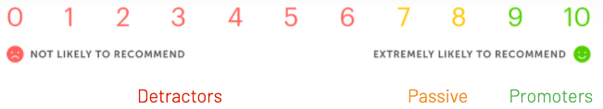
Customer Classification
“Likelihood to Recommend” reflects customer satisfaction and overall flight experience.
Based on this score, we classify passengers into three categories as shown:
We studied customers under these categories to get an insight into what makes their experience pleasant or unsatisfactory.
Our goal is to identify areas of improvement; and convert detractors and passive passengers into promoters.

Slide 4
Exploratory Data Analysis
Some demographic variables were examined to give us a better insight into FlyFast’s customer base:
Age
Gender
Type of Travel : What is the purpose of travel ?
Class: Which tier of flight ? Ex: Economy, Business class
Price Sensitivity: How important is pricing for the customer ?
Number of Frequent Flyer Accounts

Slide 5
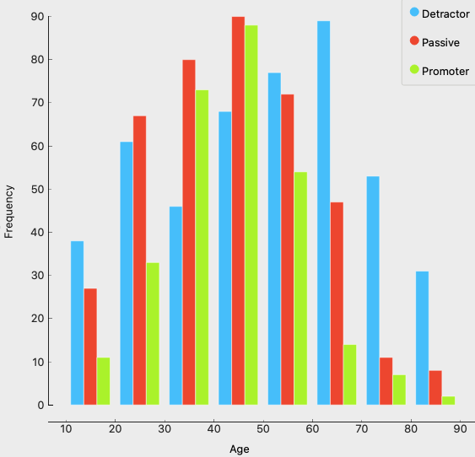
Age
Over 50% of the passengers lie in the moderate age range of 30-60 years.
This range is also the source of most promoters.
Beginning from around 30 years, we see a gradual increase in detractors - till there’s an overwhelming majority of them in the 60-90 years range.
→ Passenger in the higher age range seem to have unsatisfactory flying experience.

Slide 6
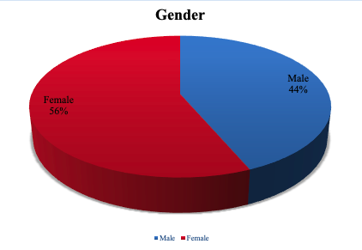
Gender
Our customer base has higher proportion of female passengers.
It is imperative that we ensure they have a wholesome experience.
Both genders have ample customer flying for business and personal reasons, with varying levels of satisfaction. We will dive deeper into those later.

Slide 7
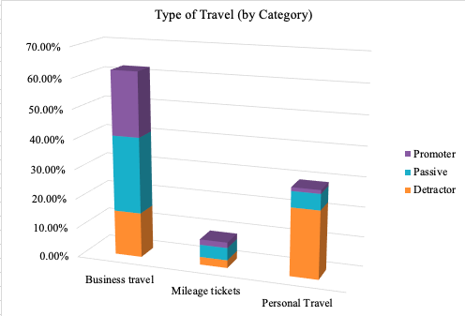
Type of Travel (by Category)
Well over 60% customers fly for business purposes, and a little over 30% travel for person reasons.
It is evident that maximum business travelers are either promoters or passive. On the contrary, most of those on personal travel are detractors

Slide 8
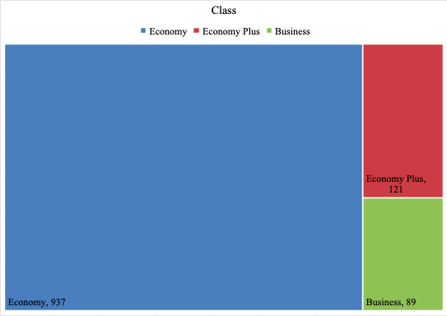
Class of Travel
Among class of flying, an overwhelming 82% of our customers are Economy passengers.
Economy Plus is the next most popular type, followed by Business class.
10%
82%
8%

Slide 9
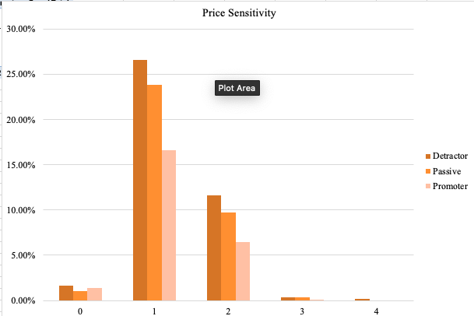
Price Sensitivity
This indicates on a scale of 0-4, how important is the pricing of ticket for customers, and consequently how it might affect their choice of airline, class etc.
Majority of the customer have a moderate price sensitivity in the range 1-2.

Slide 10
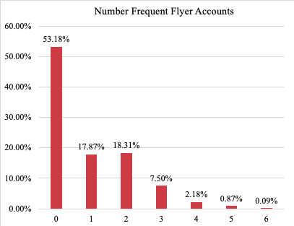
Number of Frequent Flyer Accounts
Frequent Flyer programs usually offer benefits such as discounts, upgrades, priority seating etc. to those who fly with the airline quite often. Having such an account influences a customer’s choice of flight and ticket.
We see that over half our customers have not enrolled for this program.
A small portion have 1-2 accounts, and even fewer with as many as 3-5.

Slide 11
Promoters vs Detractors: FlyFast Airways
Based on these explorations and in depth data modeling, we have identified some common attributes that characterize Promoters and Detractors.
Detractors:
Female
Personal Travel
Age >60
Flight Time is approximately 1.5 hours, or higher
Promoters :
Male
Business Travel
Female, on business travel
Age >=30, <60
Flight time is approximately <45 minutes, 45 minutes - 1.5 hours

Slide 12
Our competitors: Cheapseats Airlines
Having the highest customer rate the airline is successful in retaining most flyers as promoters.
Age group between 29-43
Sensitive to price
Gender is Male
Type of travel is Business
Type of class is Economy
The people falling under the age group 29-43 are mostly married and have a family and this category prefers economy class as they are more sensitive to price, turning more people to fly with the airlines. Airline is more popular between the male gender. Business firms also prefer airlines because of the cheap rates of economy class and better quality provided. So the experience of economy might be good.

Slide 13
Our competitors: Sigma Airlines
Again in Sigma based on our data analysis and exploration, we observed these personas to be a promoter.
Male Business Purpose Travelers
Delay in Departure and Arrival less than 1 hour
No Flight Cancellation
Business travelers will definitely want their airline to make them reach at their destination on time, so Sigma Airline is more famous between the business travelers. By an overall overview we can come to a conclusion that the airlines is more preferred between the business travelers with less amount of delay and no flight cancellation.

Slide 14
Marketing Plan
Overall, our Detractors have a majority of Females, on personal travel.
People on personal travel are always likely to recommend our service if they have a good experience, and should not be sidelined. We recommend introducing travel discounts, limited time offers (maybe in collaboration with tourism agencies, hotels) for this segment.
On some further examination, we found that among these females, on personal travel, most of them had age>=64.5 years. Reserving preferred seats, providing baggage assistance during boarding to ensure a more comfortable flight would be a good option too.
We should be sensitive to the specific needs of females to ensure they have a satisfactory experience. Introducing a separate lactation room, not accessible to the general public is an option.

Slide 15
Marketing Plan
Among Passives, we see a large portion of Females again, but those traveling for Business purposes.
Knowing that we have a sizable portion of the same segment among Promoters too, it is plausible that with a few perks, we can nudge them to become a Promoter as well.
Business travelers usually already have preferred boarding and seats. So we can enhance their experience in other ways - qualitative food and options for all types of diets.
Improving on board entertainment for longer flights.
Encouraging them to get “Frequent Flyer” accounts, by promoting the benefits of acquiring “sky miles” and redeeming them for upgrades, dining or shopping coupons etc.

Slide 16
Marketing Plan
Among promoters, we have a blend of male and female passengers with one common attribute - Business Travel.
We recognize that this subset represents some of our happiest customers, and we should maintain our current standard of service to retain them.
They too should be encouraged to enroll in and enjoy the benefits of “Frequent Flyer” programs.
Airline-owned or partner lounges and bars at airports should be accessible, and occasional discounts/schemes if possible can be offered.

Slide 17
Thank you !

